Slide 1

Telco customer Churn Prediction
Machine Learning classification problem - Supervised learning

Slide 2
Problem Statement
Predict the potential churn on customers based on numerical and categorical features.
Customer churn is of utmost importance for businesses due to the fact that retaining existing customers is generally more lucrative than acquiring new ones.
Generally, attracting new customers often requires significant marketing and advertising expenses, as well as the cost of providing incentives to entice them to switch from a competitor.
For Telco companies, the difference in cost between acquiring and retention is 5 times more expensive*.
This industry has High level of competition and low switching costs, meaning that customers can easily switch to a competitor if they are dissatisfied.

Slide 3
Dataset
The dataset analyzed is a dataset from Kaggle, which shows a snapshot of a set of customers from a telco company's in a given time.
The dataset generally contains:
A Churn flag (Our target variable)
Services that each customer has signed up to
Customer demographics
Customer account information: how long they’ve been a customer, contract, payment method, paperless billing, monthly charges
17/20 variables are categorical.
 | Feature | Description
0 | Customer ID | Contains customer ID
1 | gender | Whether the customer is a male or a female
2 | SeniorCitizen | Whether the customer is a senior citizen or not (1, 0)
3 | Partner | Whether the customer has a partner or not (Yes, No)
4 | Dependents | Whether the customer has dependents or not (Yes, No)
5 | tenure | Number of months the customer has stayed with the company
6 | PhoneService | Whether the customer has a phone service or not (Yes, No)
7 | MultipleLines | Whether the customer has multiple lines or not (Yes, No, No phone service)
8 | InternetService | Customer’s internet service provider (DSL, Fiber optic, No)
9 | OnlineSecurity | Whether the customer has online security or not (Yes, No, No internet service)
10 | OnlineBackup | Whether the customer has online backup or not (Yes, No, No internet service)
11 | DeviceProtection | Whether the customer has device protection or not (Yes, No, No internet service)
12 | TechSupport | Whether the customer has tech support or not (Yes, No, No internet service)
13 | streamingTV | Whether the customer has streaming TV or not (Yes, No, No internet service)
14 | streamingMovies | Whether the customer has streaming movies or not (Yes, No, No internet service)
15 | Contract | The contract term of the customer (Month-to-month, One year, Two year)
16 | PaperlessBilling | Whether the customer has paperless billing or not (Yes, No)
17 | PaymentMethod | The customer’s payment method (Electronic check, Mailed check, Bank transfer, Credit card)
18 | MonthlyCharges | The amount charged to the customer monthly
19 | TotalCharges | The total amount charged to the customer
20 | Churn | Whether the customer churned or not (Yes or No)

Slide 4
Machine Learning Workflow
Exploratory Data Analysis helps:
Understand the dataset
Identify patterns, relationships, and anomalies
Check for missing or inconsistent values
Select appropriate machine learning models, preprocessing techniques, and feature engineering strategies
Detect and address potential biases and outliers.
Raw Dataset
Data Wrangling +EDA

Slide 5
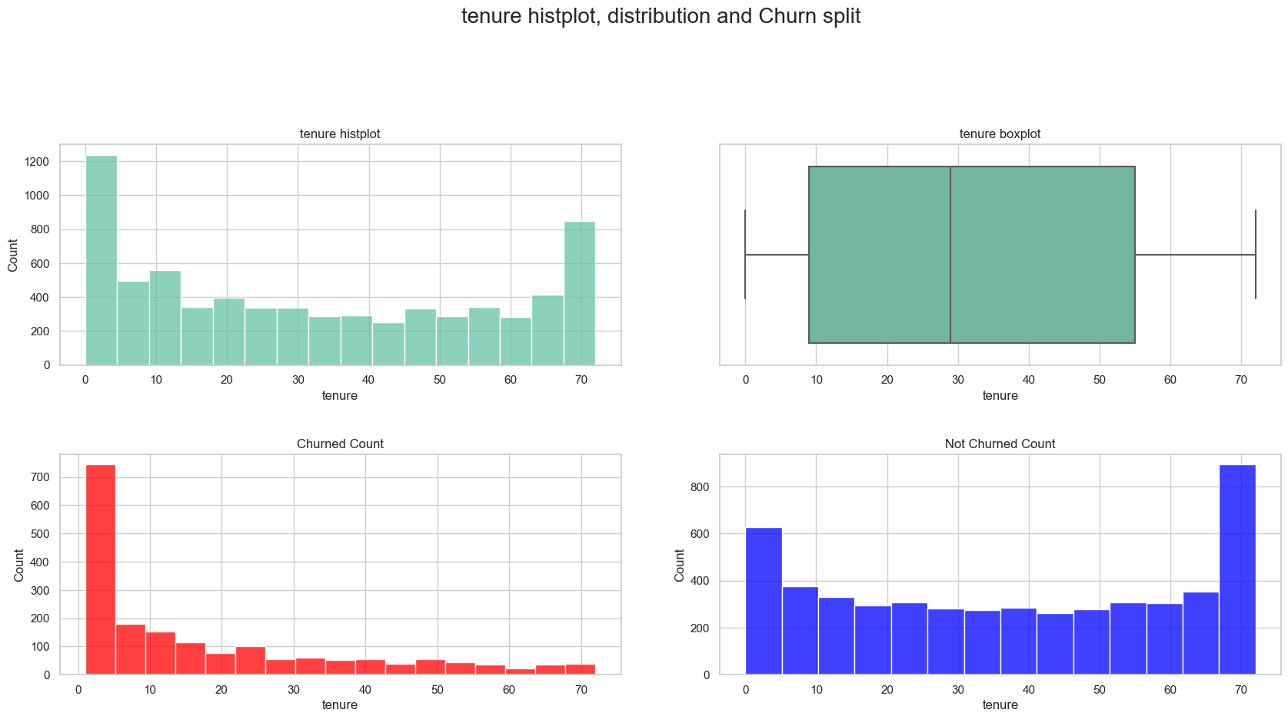
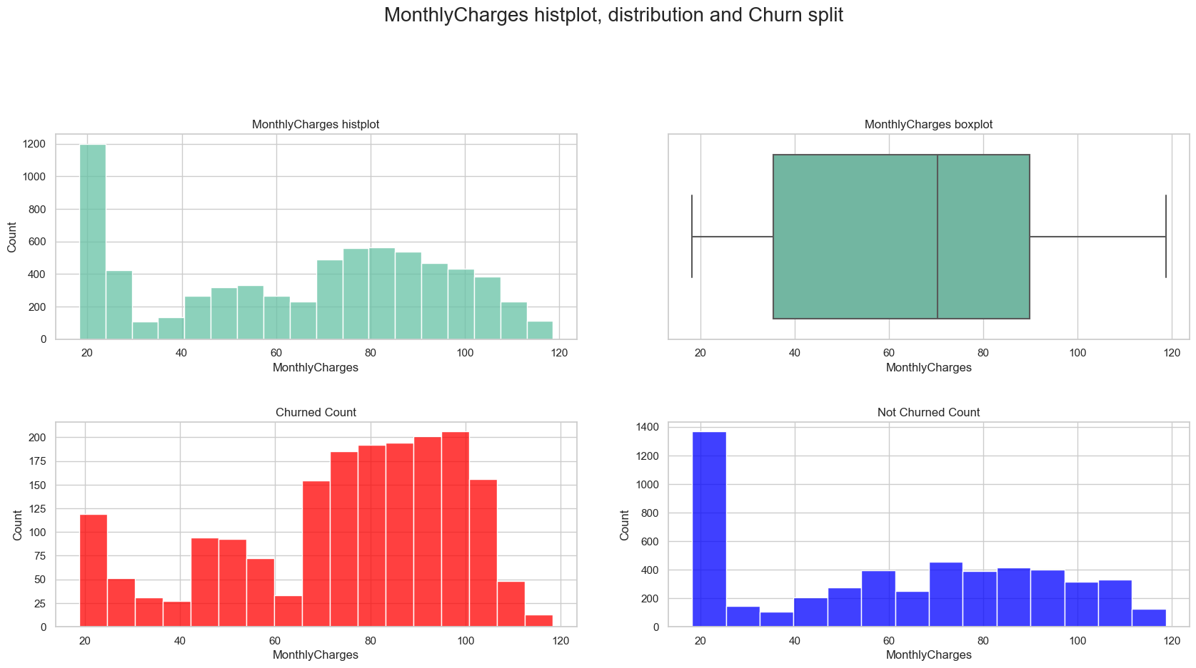
EDA – Numerical data
Main takeouts after data Cleaning, Wrangling and Exploration:
None of the numerical variables (Tenure, MonthlyPayments, TotalPayments) is normally distributed, relevant for scaling
Churn has a negative correlation with tenure
Churn has a positive correlation with MonthlyPayments
There is a threshold for MonthlyPayments where churn is triggered for a relevant amount of customers.

Slide 6
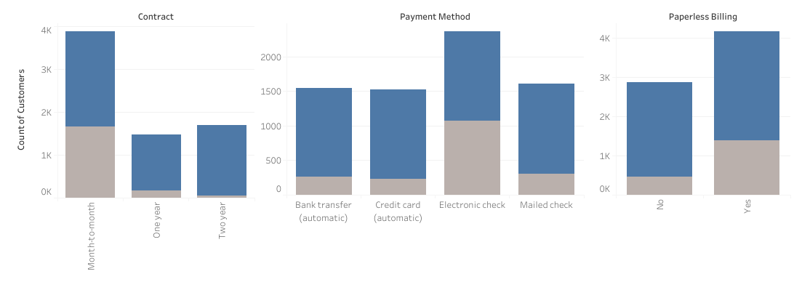
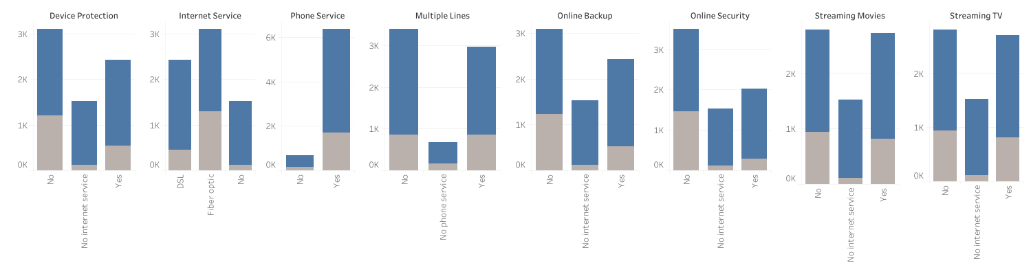
EDA – Categorical Data
Main takeouts after data Cleaning, Wrangling and Exploration:
Crosseling contributes to churn reduction for some products.
Contract type and payment options are considerably relevant, with Month-to-Month based Contract, PaperlessBilling particularly with Electronic check seem to be strong churn drivers.

Slide 7
Machine Learning Workflow
Feature engineering involves selecting and transforming raw data into meaningful features for machine learning algorithms.
It improves accuracy by selecting important features and reducing dimensionality.
2. Feature engineering increases interpretability and reduces overfitting.
3. It can also be used to normalize or standardize data for consistency.
Raw Dataset
Data Wrangling +EDA
Feature Engineering

Slide 8
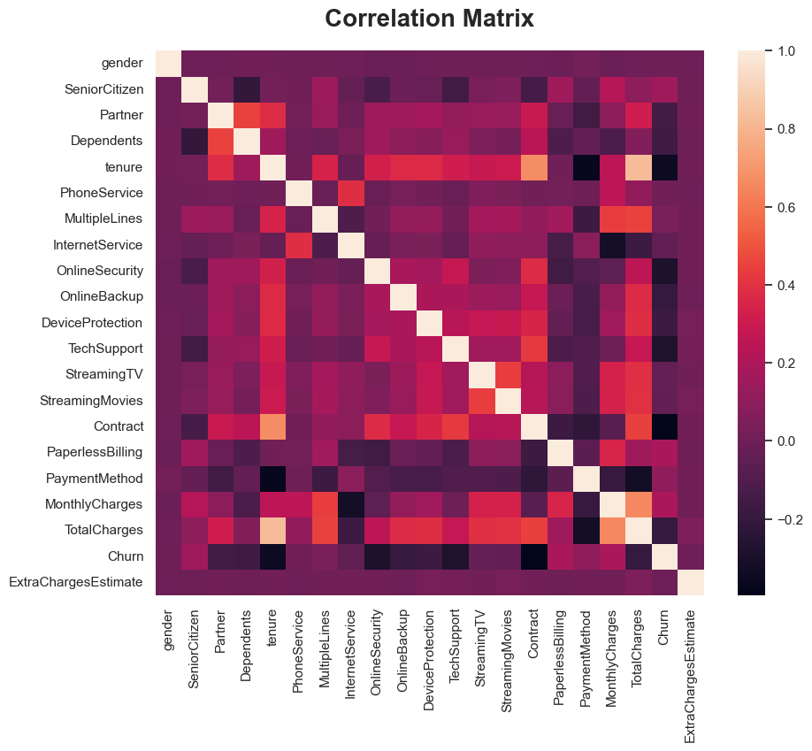
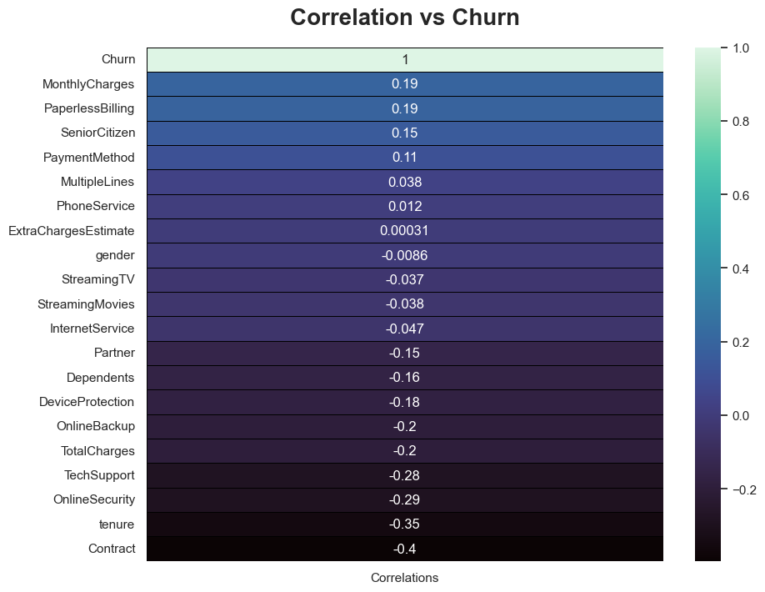
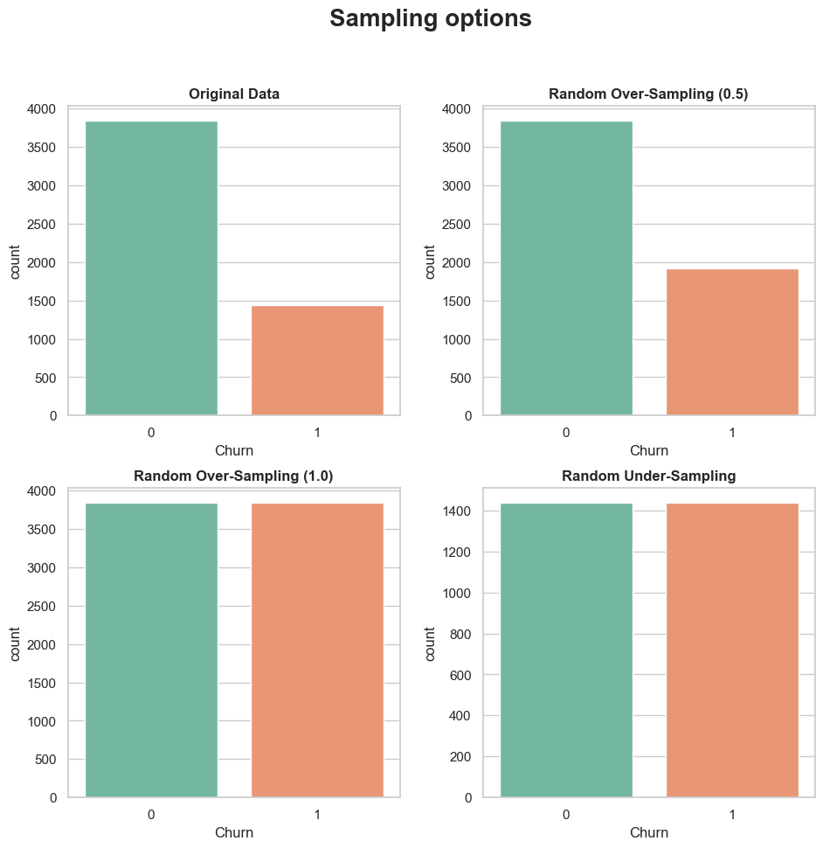
Selecting and transforming data into meaningful features
Correlation Matrix
Correlation vs Target
Sample Imbalance Mitigation
Feature Engineering
Scaling numeric Variables
Categorical Encoding
Statistical significance
MinMaxScaler (non gaussian data).
Label encoding
Chi-Squared (categ.)
ANOVA (Numeric.)

Slide 9
Machine Learning Workflow
Machine learning is a subset of artificial intelligence that involves training algorithms to learn patterns in data and make predictions or decisions.
It uses statistical models to analyze and extract insights from data without being explicitly programmed.
It can be supervised (knowing pre-defined target), unsupervised (no predefined target)
Raw Dataset
Data Wrangling +EDA
Feature Engineering
Machine Learning Pipeline
+
Benchmarking

Slide 10
Example of ML Algorithm – Training
Here you can see the data that was used to train the tree flow through the tree.
This data is called training data because it was used to train the model.
Because in this example the tree grew until it was 100% accurate, this tree maps each training data point perfectly to which Customer from the sample actually Churned.

Slide 11
Example of ML Algorithm – Cross Validation
what matters more is how the tree performs on previously-unseen data.
To test the tree's performance on new data, we need to apply it to data points that it has never seen before. This previously unused data is called test data.
This serves as a “Reality Check” to see how the model would perform outside a training environment.

Slide 12
Machine Learning Pipeline
Iterate over 4 sampling opt.
Iterate over 5 different ML Models.
Gridsearch Parameters
Reverse engineer feat.
Sampling options
LogisticRegression
Parameters
Feat. Reduction
RandomForestClassifier
Parameters
Feat. Reduction
Pre-Processed Data
GradientBoostingClassifier
Parameters
Feat. Reduction
XGBClassifier
Parameters
Feat. Reduction
MLPClassifier
Parameters
Feat. Reduction
In each step, the models performance is maximized to choose the overall best model possible.
This code could be used for any ML Classification problem.

Slide 13
Machine Learning - Benchmarking
 | sampling | ROC_AUC | accuracy | precision | recall | f1_score | model
1 | Oversampling05 | 0.84747 | 0.80057 | 0.62594 | 0.65707 | 0.64112 | GradientBoostingClassifier
2 | gridsearch | 0.82840 | 0.74521 | 0.51901 | 0.82199 | 0.63627 | GradientBoostingClassifier
3 | Undersampling | 0.85058 | 0.74521 | 0.51901 | 0.82199 | 0.63627 | GradientBoostingClassifier
4 | feature_reduction | 0.85007 | 0.74663 | 0.52087 | 0.81675 | 0.63609 | XGBClassifier
5 | Oversampling05 | 0.83622 | 0.78850 | 0.60000 | 0.65969 | 0.62843 | LogisticRegression
AutoML (H20) Package to benchmark results
 | sampling | ROC_AUC | accuracy | precision | recall | f1_score | model
1 | Original Sample | 0.8147475 | 0.749828 | 0.5231197 | 0.7132375 | 0.6014422 | StackedEnsemble_

Slide 14
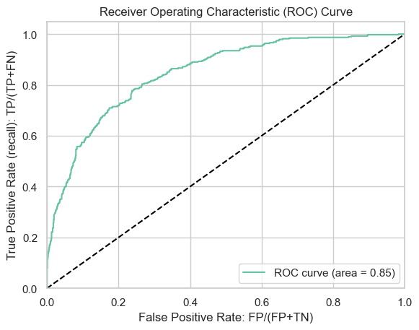
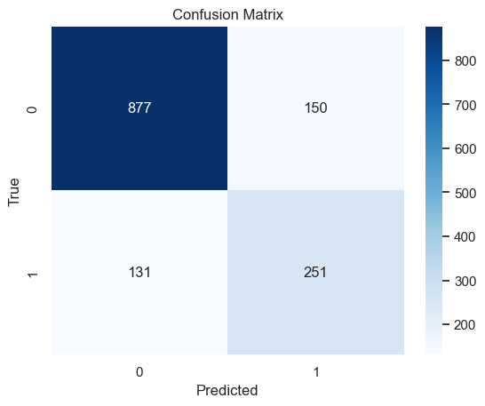
Machine Learning - Benchmarking
 | sampling | ROC_AUC | accuracy | precision | recall | f1_score | model
1 | Oversampling05 | 0.84747 | 0.80057 | 0.62594 | 0.65707 | 0.64112 | GradientBoostingClassifier

Slide 15
Machine Learning Workflow
Raw Dataset
Data Wrangling +EDA
Feature Engineering
Machine Learning Pipeline
+
Benchmarking
Takeouts

Slide 16
Takeouts
Feature Importance Table
The model has an acceptable level of accuracy, outperforming AutoML H20 although in a real scenario, adding more data or manipulating the dataset using domain knowledge would probably increase its overall performance.
A quick win should be to disincentivize Electronic Check as a payment method, and incentivize longer Contracts.
As shown in the EDA, the contract type, tenure and MonthlyCharges are the most relevant features related to the target variable churn
Regarding services, the most relevant are TechSupport and OnlineSecurity, although crosseling as a whole contributes to churn reduction.
features | importance
Contract | 0.47403
tenure | 0.16402
MonthlyCharges | 0.14029
OnlineSecurity | 0.07113
TechSupport | 0.06648
PaymentMethod | 0.02326
InternetService | 0.01426
OnlineBackup | 0.01342
Dependents | 0.00895
MultipleLines | 0.00856
PaperlessBilling | 0.00536
StreamingMovies | 0.00362
SeniorCitizen | 0.00313
Partner | 0.00281
DeviceProtection | 0.00039
StreamingTV | 0.00029

